Slide 1
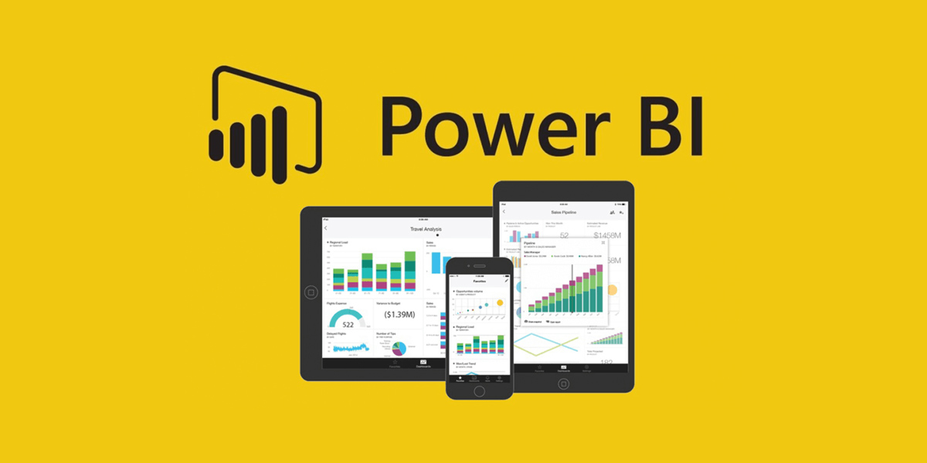
Introduction to Power BI

Slide 2
Introduction to Power BI
What is Power BI?
Power BI is a powerful Business Intelligence (BI) tool developed by Microsoft.
It allows users to connect, analyze, and visualize data from multiple sources.
Helps in making data-driven decisions through interactive dashboards and reports.
Why Power BI?
Easy to use with drag-and-drop interface
Interactive visuals and real-time data updates
Integration with various data sources (Excel, SQL, Cloud services, etc.)
Strong community and Microsoft support

Slide 3
Key Components of Power BI
Power BI Desktop
A free application for creating reports on your local machine
Used by data analysts to clean, model, and visualize data
2. Power BI Service (Cloud)
An online platform to share and collaborate on reports and dashboards
3. Power BI Mobile
Mobile app to access reports and dashboards on the go
4. Power BI Gateway
Bridge to connect on-premise data to the Power BI Service

Slide 4
Power BI Workflow
Basic Workflow Steps:
Connect to Data – Excel, SQL Server, Web APIs, etc.
Transform Data – Using Power Query Editor
Build Visuals – Charts, KPIs, maps, etc.
Create Reports – Combine visuals into an interactive report
Publish and Share – Upload to Power BI Service and share with others

Slide 5
What You Will Learn in This Course
🔹 Data Visualization
Creating interactive dashboards in Power BI
Using charts, graphs, and maps for insights
🔹 Power Query Editor
Data cleaning, transformation, and merging
Handling missing values and optimizing data models
🔹 DAX Functions (Data Analysis Expressions)
Writing calculated columns & measures
Using SUM, SUMX,COUNT, CALCULATE, FILTER, RANKX, and more
🔹 End-to-End Projects
Real-world datasets from industries like sales, finance, healthcare
Complete project workflow: Data Cleaning → Analysis → Visualization → Insights

Slide 6
Thanks for Watching!

